Slide 1

3DIC Partitioning
Turning integrated circuits 3D
Quentin Delhaye

Slide 2
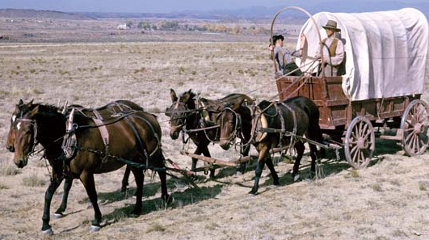

Fit as much as you can

Slide 3
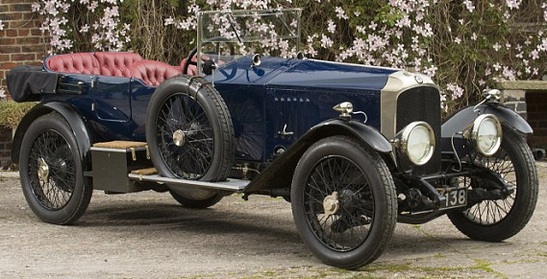
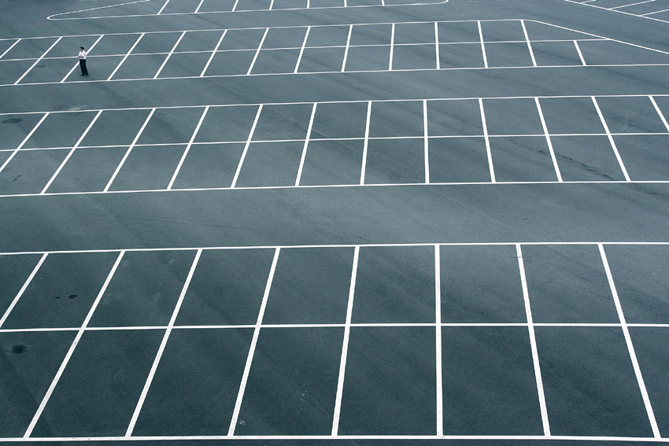
Shrink the car

Slide 4
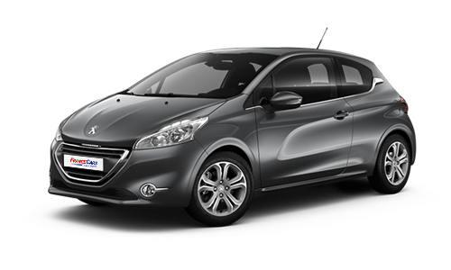
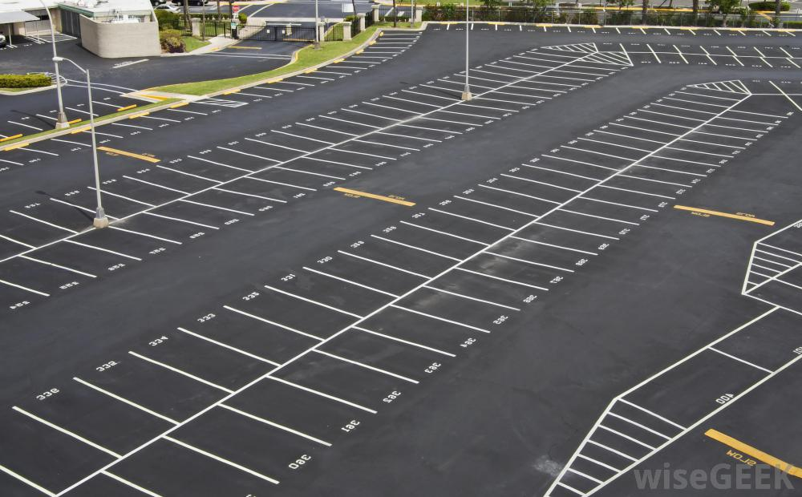
Physical limitation
Notes:
We can actually go from the paradox of the situation. The obvious solution is to build a two stories building to hold all the cars. But the IC industry took the other way for the past 30 years, i.e. they shrank the cars to fit them all.
Why is that? Well, the 3D may be tempting for various reasons, but it's not that simple.
But what is an 'IC'?

Slide 5
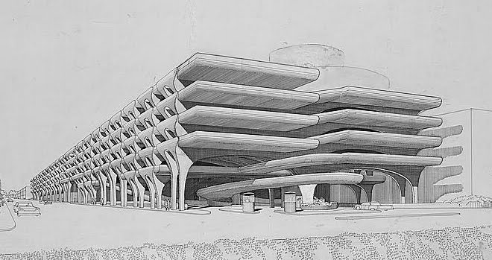
Go 3D

Slide 6
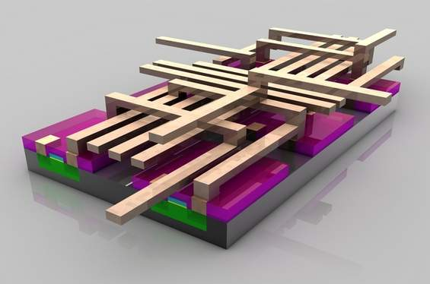

Slide 7
Planar 2D IC
Metal
Gate
Substrate
Planar 2D IC: only one transistor layer

Slide 8
What is a 3D IC?
Face-to-Back (past)
Face-to-Face (present)
Transistor-on-transistor
(future)

Slide 9
What is a 3D IC?
Face-to-Back (past)
Face-to-Face (present)
Transistor-on-transistor
(future)
Somebody needs to decide what goes where

Slide 10
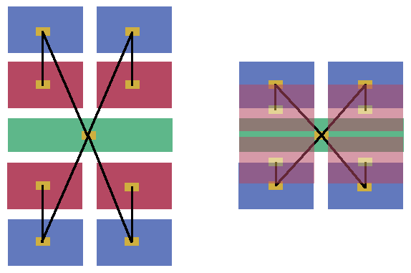
3D benefit: shorter connections
Increased performance
Decreased system power consumption
Improved area utilisation
Notes:
Shorter connections because all the blocks are closer to each other: Red and Blue get stacked, Blue and Green get closer on the same layer thanks to Red moving to another layer.

Slide 11
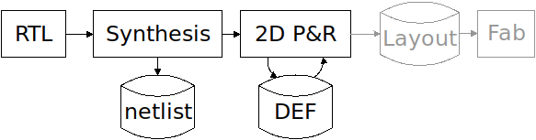
2D flow...
Place and route (P&R): QRouter, Graywolf, FGR, ...

Slide 12
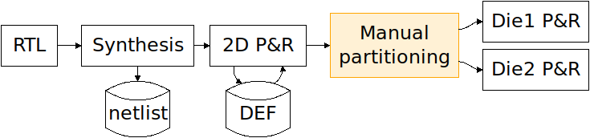

... Extended to 3D
Pick which standard cell or module goes where

Slide 13
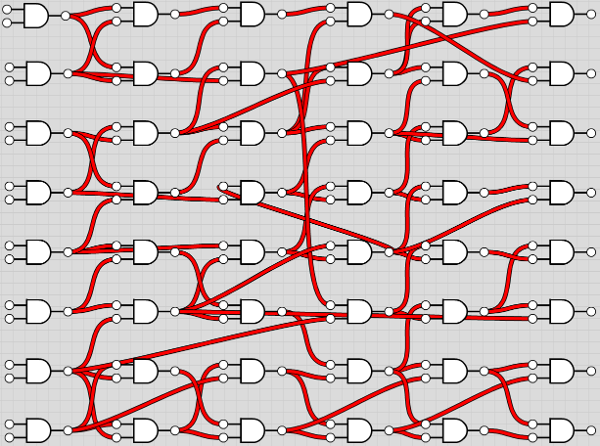
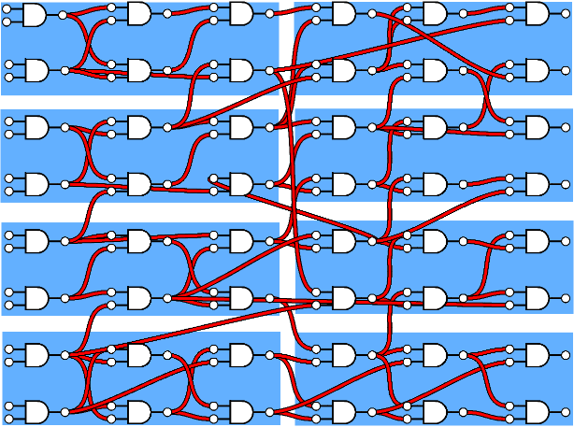
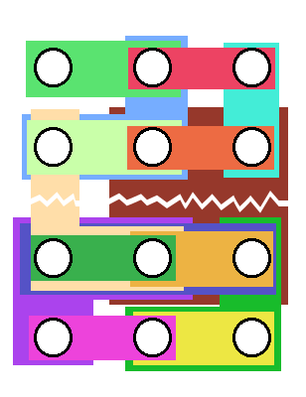
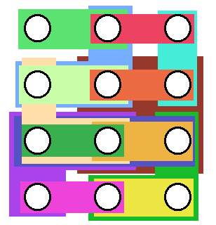
Steps to go 3D
Clustering
Hypergraph
Partitioning

Slide 14
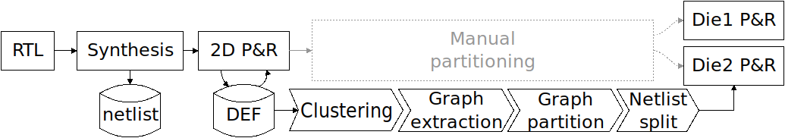

Automated 3D flow

Slide 15
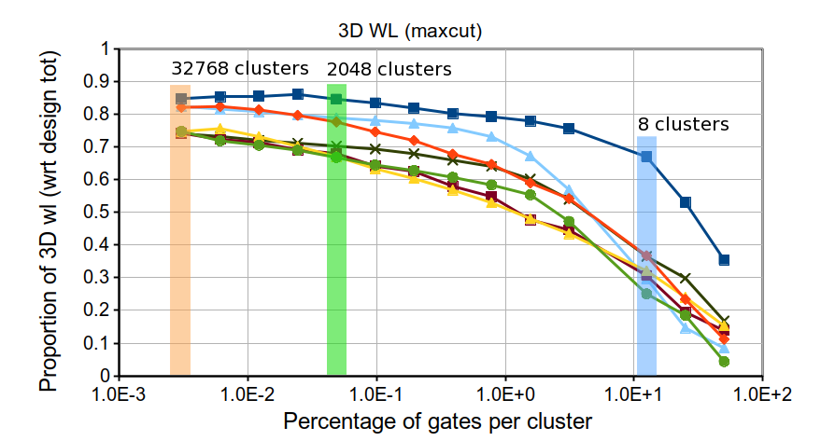
There is an optimum grain

Slide 16
Automated 3DIC partitioning

